Slide 1

Building Collapse Modelling and Simulation
Submission 2 : Individual Paper Presentation
Name : | Mirza Ahmad Shayer
ID : | 22273008
Course : | Petri Net Theory And Modeling Of Systems
Faculty : | Annajiat Alim Rasel [AAR]

Slide 2
In today’s society building collapse is often unheard of or very rare. Still at any time any building can collapse. In many frequent earthquake regions, buildings collapse in most cases. Building collapse is still not very well understood. That’s why building collapse simulation and modelling is very important, popular and necessary to design better and safer buildings.
Many mathematical models are often used to determine building collapse. In the cases of earthquake, building models are oscillated under particular frequencies. Then all factors are taken into account to calculate how the building collapses. In many cases the same models can be used to measure building collapse in any case. Here we focus on the building collapses rather than the reason for the collapses and how they are measured.
Thus, building collapse modelling and simulation is very important for safety and future proofing buildings to withstand any structural damage, earthquakes or other issues that can lead to a collapse. The simulations can also be used to understand building collapse physics as well.

Slide 3
The paper is given below.
Paper Title: Collapsing Response of a Nonlinear Shear-Beam Building Model Excited by Horizontal and Vertical Strong-Motion Pulses at Its Base by Hamid Abbasgholiha, Vlado Gičev, Mihailo D. Trifunac, Reza S. Jalali and Maria I. Todorovska – 2023
Paper Link - https://doi.org/10.3390/buildings13071712

Slide 4
The authors in the paper, aims to use numerical simulations to improve the understanding of the sequence of phenomena that accompany the collapse of buildings during damaging earthquakes. A nonlinear shear-beam model of a building that is excited by a sequence of large horizontal and vertical displacement pulses at its base model is proposed.
The propagation of the input pulses through the structure is simulated by a finite difference scheme. The properties of the model to be similar to those of a seven-story hotel in San Fernando Valley of the Los Angeles metropolitan area, which was damaged during the 1994 Northridge, California earthquake.
The results of one example of collapsing response of the model to hypothetical but plausible ground motion close to an earthquake fault. It illustrates the response only for a sequence of horizontal and vertical pulses. The differences in the nature of the collapsing sequence for vertical upward and downward pulses of ground motion are shown.

Slide 5
The collapse of a building is a complex physical process, characterized by large material and geometric nonlinearities and interaction between the nonlinear response and the excitation, which develop as the response progresses.
In this paper, the building model analyzed is a fixed-base shear beam with variable stiffness along its height. Assumed that the building has relatively large plan dimensions, compared to the height, in order for it to deform as a whole mostly in shear. The response of the model is computed in the time domain by tracing the propagation of the input displacement pulses using a finite difference scheme. Earthquakes, tsunami, hurricanes, explosions, vehicle impact, fires, and terrorist attacks, may cause critical damage to structures that can lead to collapse. Analyses of collapsing structures and proposals for resilient design started to appear around the year 2000.

Slide 6
The papers on methods for collapse prevention describe the following three widely used approaches.
The tie force methods provide the levels of tying, ductility, and continuity required to prevent failure and are recommended for structures with low risk of failure.
Alternative Load Path (ALP) method can be introduced, when the ALP approach cannot provide sufficient load distribution ability
The key element design methods, which introduce key structural elements providing strength of last resort.
The key characteristic of the above proposed methods for prevention of structural failure, leading to collapse, is the educated assumption by the design engineer about which structural members may initiate the failure sequence. Identifying these members is a straightforward decision in the case of placement of explosives for demolition of structures, or when the impact by heavy objects is known in advance. However, these members are impossible to anticipate for shaking by large earthquakes.

Slide 7
The approach used in this paper differs from the previous studies in that the collapse begins spontaneously with the occurrence of large strains and instabilities caused by the ground motion, and then continues to be governed by the large nonlinear waves and by the action of gravity. The approach enables studying the locations in the structure at which the collapse is initiated and the factors that influence its initiation, spreading, and the sequence of collapsing displacements.

Slide 8
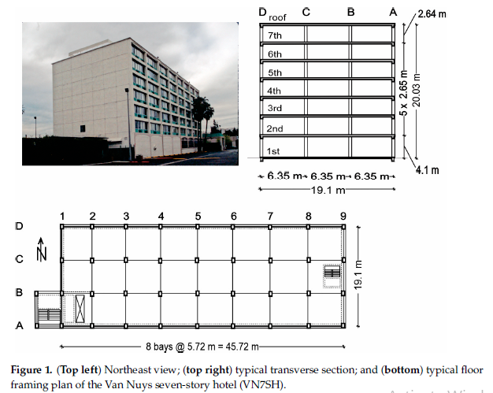
The real hotel during the earthquake with building plans

Slide 9
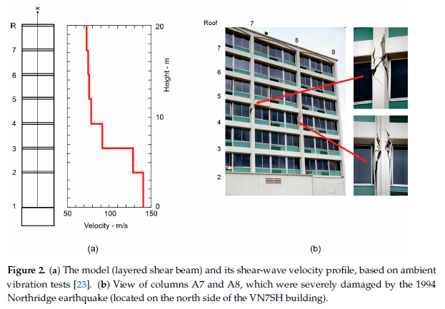
Damages and Beam shear

Slide 10
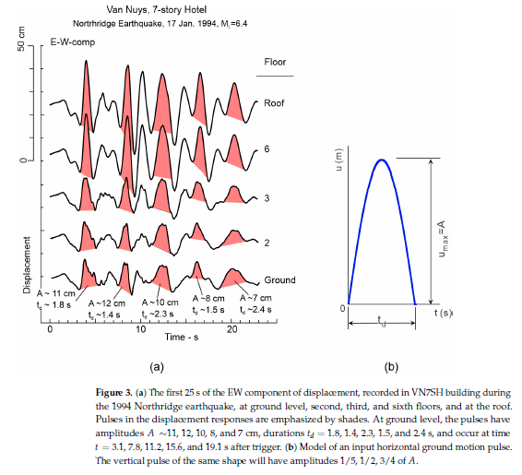
Earthquake Frequency

Slide 11
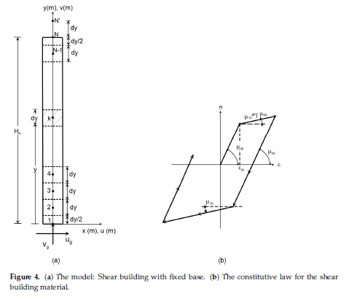
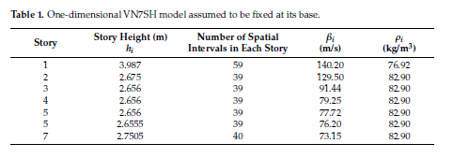
Material and Model

Slide 12
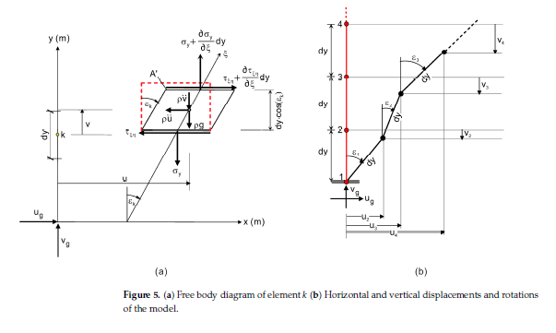

Equations and Math

Slide 13
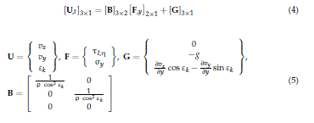

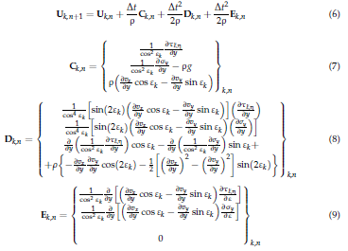

Equations and Math (Continued)
The Finite Difference Scheme
Compatibility equation
Stresses, Boundary Conditions, and Displacements

Slide 14
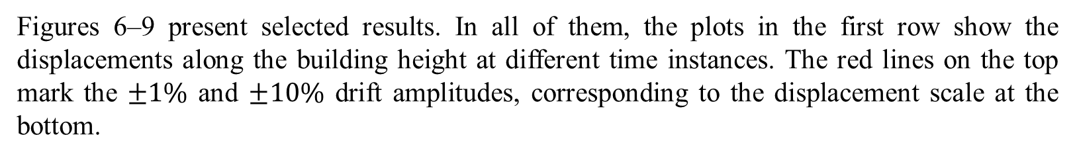
Result Analysis
The observed damage in VN7SH as a qualitative guide to define cases that would be interesting to investigate is utilized. No attempt to model its response realistically and in detail since it would need accurate modeling of the building, which, in turn, would lead to complexities in the results, making it difficult to interpret them.
Figures 6–9 present selected results. In all of them, the plots in the first row show the displacements along the building height at different time instances. The red lines on the top mark the $±1\%$ and $±10\%$ drift amplitudes, corresponding to the displacement scale at the bottom.

Slide 15
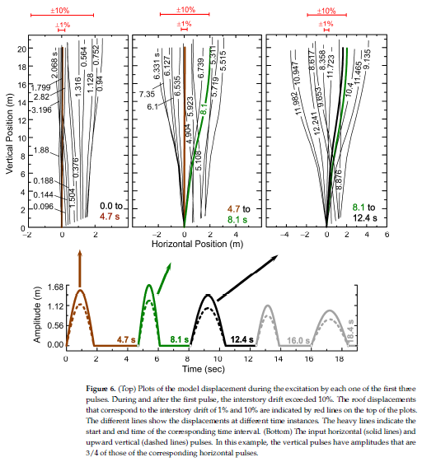
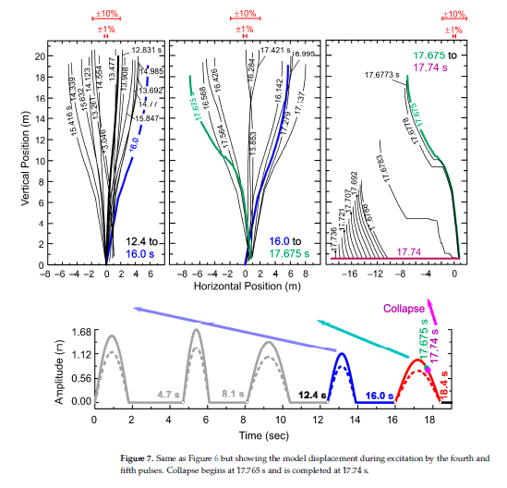
Result Analysis (Continued)

Slide 16
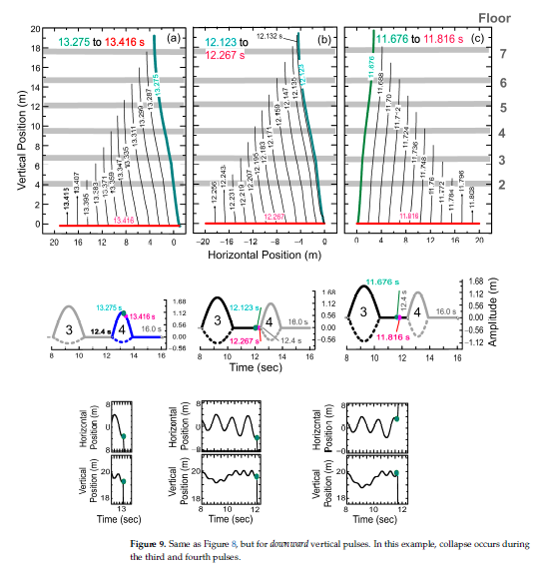
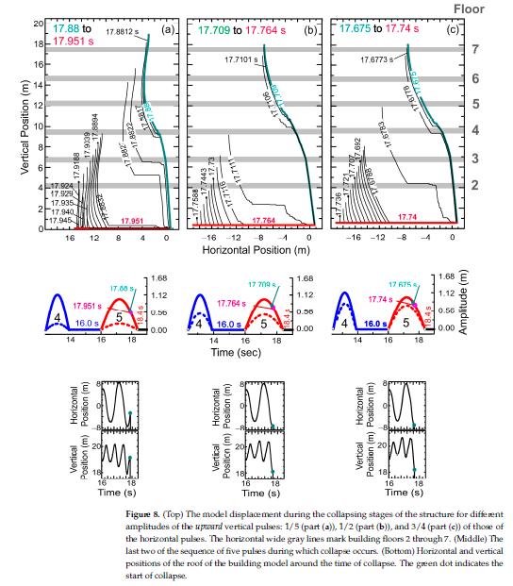
Result Analysis (Continued)

Slide 17
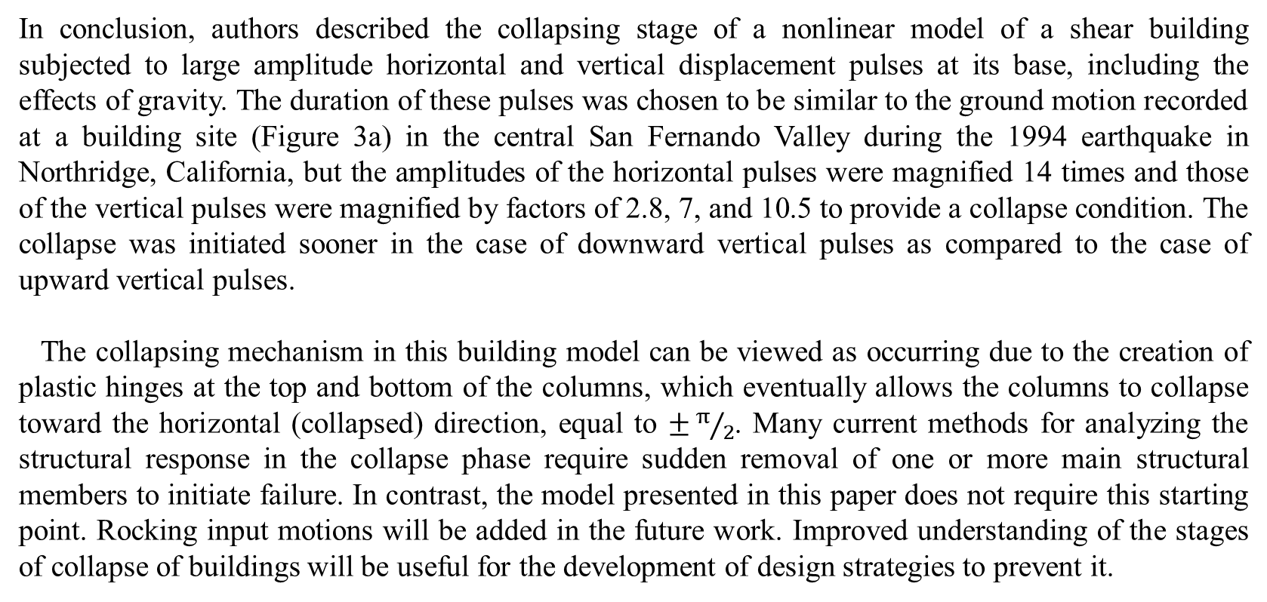
In conclusion, authors described the collapsing stage of a nonlinear model of a shear building subjected to large amplitude horizontal and vertical displacement pulses at its base, including the effects of gravity. The duration of these pulses was chosen to be similar to the ground motion recorded at a building site (Figure 3a) in the central San Fernando Valley during the 1994 earthquake in Northridge, California, but the amplitudes of the horizontal pulses were magnified 14 times and those of the vertical pulses were magnified by factors of 2.8, 7, and 10.5 to provide a collapse condition. The collapse was initiated sooner in the case of downward vertical pulses as compared to the case of upward vertical pulses.
The collapsing mechanism in this building model can be viewed as occurring due to the creation of plastic hinges at the top and bottom of the columns, which eventually allows the columns to collapse toward the horizontal (collapsed) direction, equal to $±π/2$. Many current methods for analyzing the structural response in the collapse phase require sudden removal of one or more main structural members to initiate failure. In contrast, the model presented in this paper does not require this starting point. Rocking input motions will be added in the future work. Improved understanding of the stages of collapse of buildings will be useful for the development of design strategies to prevent it.

Slide 18
Thank You
Any Questions?

